Slide 1
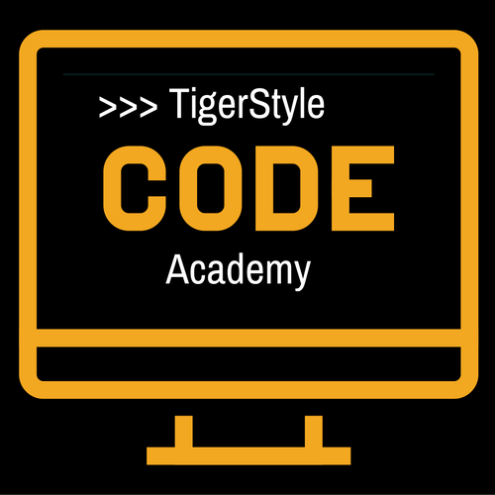
Python web scraping Tutorial - 16
16– Communicating with APIs
TigerStyle Code Academy

Slide 2

Thank you so much for subscribing!
Kunule Imbayi
Balaji
Mark Shaw
Patel Harshil
Drew Conroy

Slide 3
Communicating with APIs
Authentication
Discogs API
curl ”https://api.discogs.com/database/search?q=Michael%20Jackson&token=zmJEEMSNUWeVtSCJggxbTurauHRqcgcKBdqyTAWG”
token = “<your api key>” webRequest = urllib.request.Request(http://myapi.com, headers={“token”:token} html = urlopen(webRequest)
Unknown Waters Ahead

Slide 4
Responses
XML – extensible Markup Language
JSON – JavaScript Object Notation
XML:
<user><firstname>Sukhvinder</firstname><lastname>Singh</lastname><username>karramsos></username></user> JSON:
{“user”:{“firstname”:”Sukhvinder”, “lastname”:”Singh”, “username”:”karramsos”}}

Slide 5
Responses
XML:
<user firstname=“Sukhvinder” lastname=“Singh” username=“karramsos”></user> → bad

Slide 6
API Calls
GET
Id = 1234
http://socialmediasite.com/users/1234/posts?from=08012014&to=08312014
http://socialmediasite.com/api/v4/json/users/1234/posts?from=08012014&to=08312014
http://socialmediasite.com/users/1234/posts?format=json&from=08012014&to=08312014

